Slide 1

CMR INSTITUTE OF TECHNOLOGY:HYDERABAD Department of Computer Science and Engineering
CLASS:III- B.Tech V- SEMESTER
Regulation:R22
Course Code | Subject | POs | PSOs
22CSPC54 | Information and Cyber Security | 2,3,6,8,12 | 1
Course Outcomes (COs) & CO-PO Mapping (3-Strong; 2-Medium; 1-Weak Correlation)
COs | Upon completion of course the students will be able to | PO2 | PO3 | PO6 |  | PO8 |  | PO12 |  | PSO1
CO1 | Explain information and cyber security terminologies | 2 | 2 |  | 2 |  | 3 |  | 2 |  | 3
CO2 | Apply cryptography for security networks | 3 | 3 |  | 3 |  | 3 |  | 3 |  | 3
CO3 | Identify various cyber offences | 3 | 3 |  | 3 |  | 3 |  | 3 |  | 3
CO4 | Use standards and cyber laws to enhance cyber security | 3 | 3 |  | 3 |  | 3 |  | 3 |  | 3
C05 | IIlustrate the importance of security policies & IT Act | 3 | 3 |  | 3 |  | 3 |  | 3 |  | 3

Slide 2
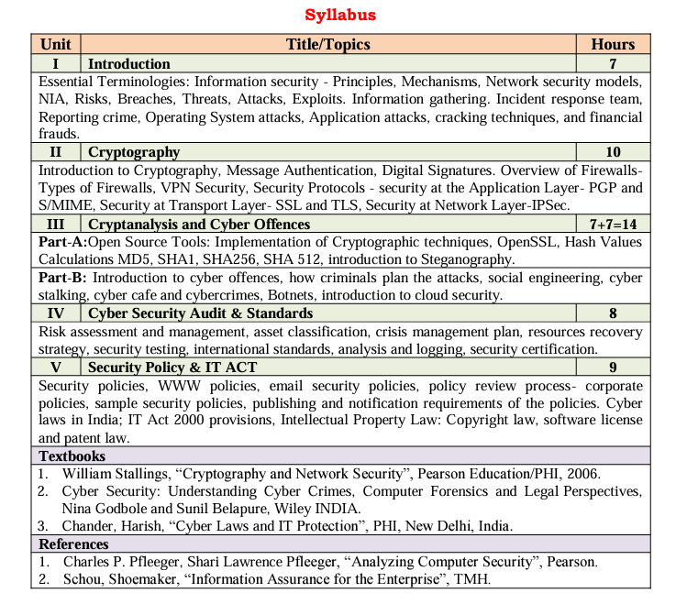

Slide 3
Open source/Free/ Trial Tools: Implementation of Cryptographic Techniques -OpenSSL
OpenSSL is an open source tool for using the Secure Socket Layer (SSL) and Transport Layer Security (TLS) protocols for Web authentication
OpenSSL offers cryptographic functions to support SSL/TLS protocols.
In SSL security, websites use digital certificates to prove their legitimacy.
OpenSSL is written in the C programming language and depend on different ciphers and algorithms to provide encryption.

Slide 4
OpenSSL is split into four principal components
libcrypto.
This is the core library for providing implementations of numerous cryptographic primitives. In addition it provides a set of supporting services which are used by libssl
Engine. The functionality of libcrypto can be extended through the Engine API.
Typically engines are dynamically loadable modules that are registered with libcrypto to provide cryptographic algorithm implementation
Libssl
This library depends on libcrypto and implements the TLS and DTLS protocols.
Applications
The applications are a set of command line tools that use the underlying libssl and libcrypto components to provide a set of cryptographic and other features such as
a) Key and parameter generation and inspection
b)Certificate generation and inspection
c)SSL/TLS test tools
d)ASN.1 inspection

Slide 5
OpenSSL characteristics
EVP. The EVP (envelope) API level provides the high-level abstract interface to cryptographic functionality separate from the concrete implementation binding.
Direct use of concrete cryptographic algorithm implementations via interfaces
The EVP layer also provides composite operations, such as signing and verifying. Certain composite operations are also provided as an EVP-level operation (such as HMAC-SHA256).
EVP also allow use of cryptographic algorithms in an algorithm-agnostic manner

Slide 6
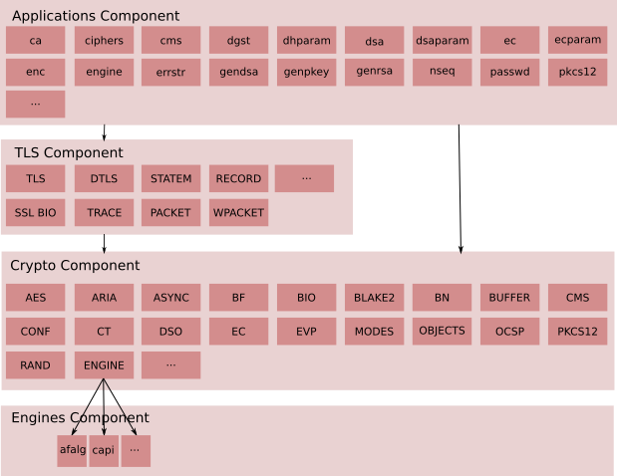
Conceptual Component View

Slide 7
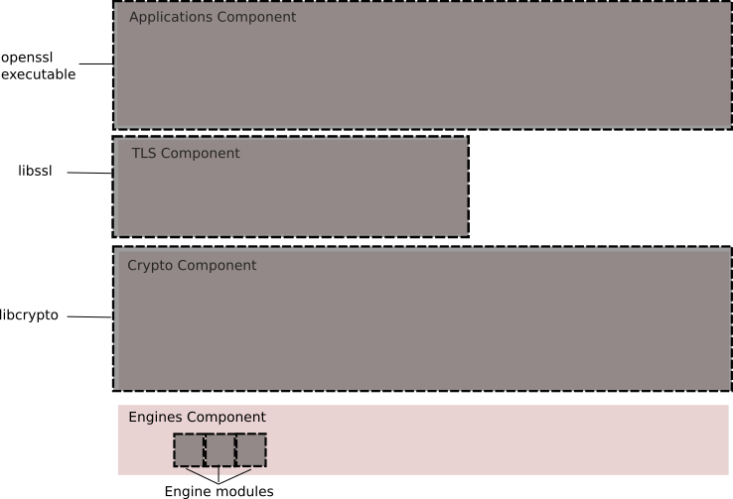
Packaging View The components described above are packaged into libraries (libcrypto and libssl) and associated engine interfaces as well as an “openssl” command line executable for running the various applications. This is illustrated in the diagram below.

Slide 8
Applications: Command line applications, e.g. ca, ciphers, cms, dgst etc
Protocols: Provides capabilities for communicating between endpoints according to standard protocols
TLS Protocols: An implementation of all supported TLS/DTLS protocols and supporting infrastructure such as:
SSL BIO: A BIO for communication using TLS
Statem: The TLS state machine
Record: The TLS record layer
Other Protocols
CMS: An implementation of the Cryptographic Message Syntax standard
OCSP: An implementation of Online Certificate Status Protocol
TS: An implementation of the Timestamp Protocol
Supporting Services: Components specifically designed to support the implementation of protocol code
Packet: Internal component for reading protocol messages
Wpacket: Internal component for writing protocol messages

Slide 9
Hash values
Hash values can be thought of as fingerprints for files. The contents of a file are processed through a cryptographic algorithm, and a unique numerical value – the hash value - is produced that identifies the contents of the file.
A hash value is a numeric value of a fixed length that uniquely identifies data. Hash values represent large amounts of data as much smaller numeric values, so they are used with digital signatures. You can sign a hash value more efficiently than signing the larger value.
If the contents are modified in any way, the value of the hash will also change significantly. Two algorithms are currently widely used to produce hash values: the MD5 and SHA1 algorithms.

Slide 10
Hashing is an algorithm performed on data such as a file or message to produce a number called a hash (sometimes called a checksum).
The hash is used to verify that data is not modified, tampered with, or corrupted. In other words, you can verify the data has maintained integrity.
Hashing is the process of transforming any given key or a string of characters into another value. This is usually represented by a shorter, fixed-length value or key that represents and makes it easier to find or employ the original string
A key point about a hash is that no matter how many times you execute the hashing algorithm against the data, the hash will always be the same if the data is the same
The most popular use for hashing is the implementation of hash tables

Slide 11
Hashing Algorithms
MD5
Message Digest 5 (MD5) is a common hashing algorithm that produces a 128-bithash.
Hashes are commonly shown in hexadecimal format instead of a stream of 1s and 0s.
---> For example, an MD5 hash is displayed as 32 hexadecimal characters instead of 128 bits.
MD5 was developed as an improvement of MD4, with advanced security purposes. The output of MD5 (Digest size) is always 128 bits. MD5 was developed in 1991 by Ronald Rivest

Slide 12
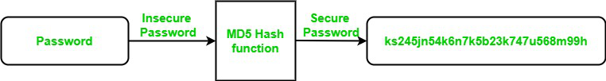
Use Of MD5 Algorithm
It is used for file authentication.
In a web application, it is used for security purposes. e.g. Secure password of users etc.
Using this algorithm, We can store our password in 128 bits format.

Slide 13
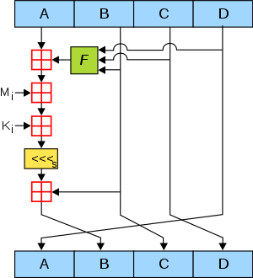

Slide 14
Working of the MD5 Algorithm
MD5 algorithm follows the following steps
1. Append Padding Bits: In the first step, we add padding bits in the original message in such a way that the total length of the message is 64 bits less than the exact multiple of 512.
Suppose we are given a message of 1000 bits. Now we have to add padding bits to the original message. Here we will add 472 padding bits to the original message. After adding the padding bits the size of the original message/output of the first step will be 1472 i.e. 64 bits less than an exact multiple of 512 (i.e. 512*3 = 1536). Length(original message + padding bits) = 512 * i – 64 where i = 1,2,3 . . .

Slide 15
2. Append Length Bits: In this step, we add the length bit in the output of the first step in such a way that the total number of the bits is the perfect multiple of 512. Simply, here we add the 64-bit as a length bit in the output of the first step. i.e. output of first step = 512 * n – 64 length bits = 64. After adding both we will get 512 * n i.e. the exact multiple of 512.
3. Initialize MD buffer: Here, we use the 4 buffers i.e. J, K, L, and M. The size of each buffer is 32 bits.
- J = 0x67425301
- K = 0xEDFCBA45
- L = 0x98CBADFE
- M = 0x13DCE476

Slide 16
4. Process Each 512-bit Block:
This is the most important step of the MD5 algorithm. Here, a total of 64 operations are performed in 4 rounds.
In the 1st round, 16 operations will be performed, 2nd round 16 operations will be performed, 3rd round 16 operations will be performed, and in the 4th round, 16 operations will be performed.
We apply a different function on each round i.e. for the 1st round we apply the F function, for the 2nd G function, 3rd for the H function, and 4th for the I function. We perform OR, AND, XOR, and NOT (basically these are logic gates) for calculating functions. We use 3 buffers for each function i.e. K, L, M.
- F(K,L,M) = (K AND L) OR (NOT K AND M)
- G(K,L,M) = (K AND L) OR (L AND NOT M)
- H(K,L,M) = K XOR L XOR M
- I(K,L,M) = L XOR (K OR NOT M)
After applying the function now we perform an operation on each block.
For performing operations we need
add modulo 2³²
M[i] – 32 bit message.
K[i] – 32 bit constant.
<<<n – Left shift by n bits.

Slide 17
Now take input as initialize MD buffer i.e. J, K, L, M.
Output of K will be fed in L, L will be fed into M, and M will be fed into J. After doing this now we perform some operations to find the output for J.
In the first step, Outputs of K, L, and M are taken and then the function F is applied to them. We will add modulo 2³² bits for the output of this with J.
In a second step, we add the M[i] bit message with the output of the first step.
Then add 32 bits constant i.e. K[i] to the output of the second step.
At last, we do left shift operation by n (can be any value of n) and addition modulo by 2³².
After all steps, the result of J will be fed into K. Now same steps will be used for all functions G, H, and I. After performing all 64 operations we will get our message digest.
Output:
After all, rounds have been performed, the buffer J, K, L, and M contains the MD5 output starting with the lower bit J and ending with Higher bits M.

Slide 18
Application Of MD5 Algorithm:
We use message digest to verify the integrity of files/ authenticates files.
MD5 was used for data security and encryption.
It is used to Digest the message of any size and also used for Password verification.
MD5 is faster and simple to understand.
MD5 algorithm generates a strong password in 16 bytes format. All developers like web developers use the MD5 algorithm to secure the password of users.
To integrate the MD5 algorithm, relatively low memory is necessary.
It is very easy and faster to generate a digest message of the original message.
Disadvantages of MD5 Algorithm:
MD5 generates the same hash function for different inputs.
MD5 provides poor security over SHA1.
MD5 has been considered an insecure algorithm. So now we are using SHA256 instead of MD5
MD5 is neither a symmetric nor asymmetric algorithm.

Slide 19
SHA
Secure Hash Algorithm (SHA) is another hashing algorithm. There are several variations of SHA grouped into four families—
SHA-0, SHA-1, SHA-2, and SHA-3:
SHA-0 is not used.
SHA-1 is an updated version that creates 160-bit hashes. This is similar to the MD5 hash except that it creates 160-bit hashes instead of 128-bit hashes.
SHA-2 improved SHA-1 to overcome potential weaknesses. It includes four versions. SHA-256 creates 256-bit hashes and SHA-512 creates 512-bit hashes. SHA-224 (224-bit hashes) and SHA-384 (384-bit hashes) create truncated versions of SHA-256 and SHA- 512, respectively.
SHA-3 (previously known as Keccak) is an alternative to SHA-2. The National Security Agency (NSA) created SHA-1 and SHA-2. SHA-3 was created outside of the NSA and was selected in a non-NSA public competition. It can create hashes of the same size as SHA-2 (224 bits, 256 bits, 384 bits, and 512 bits)

Slide 20
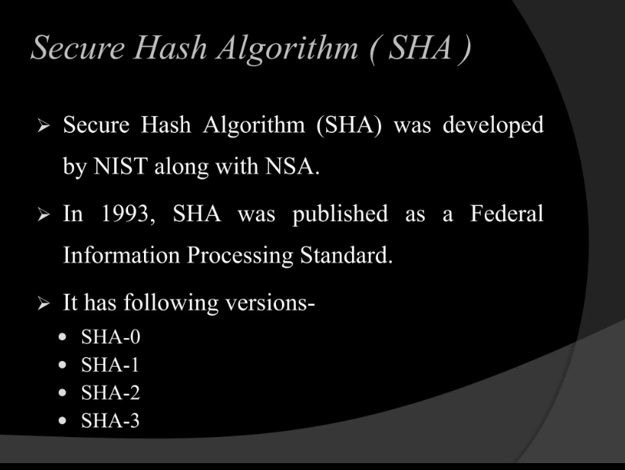

Slide 21
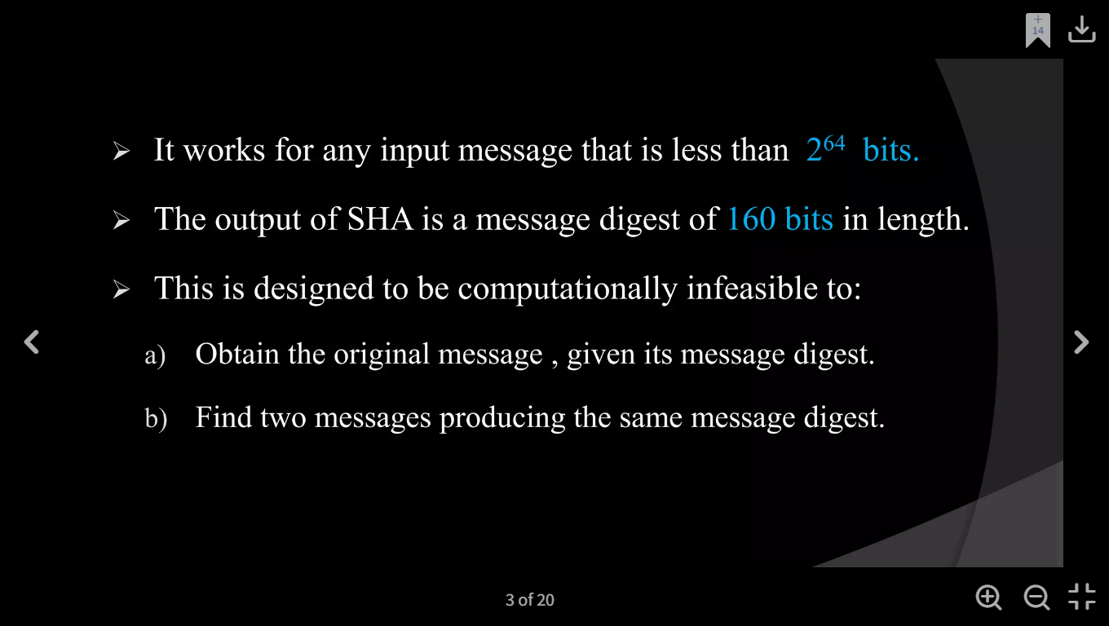

Slide 22
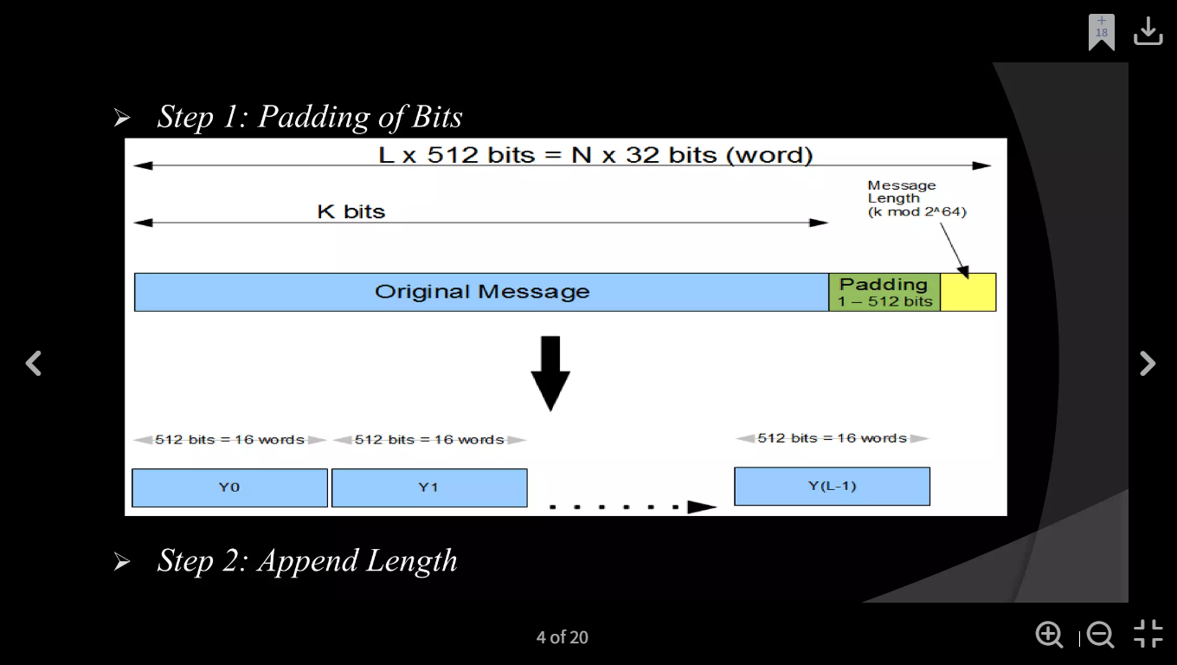

Slide 23
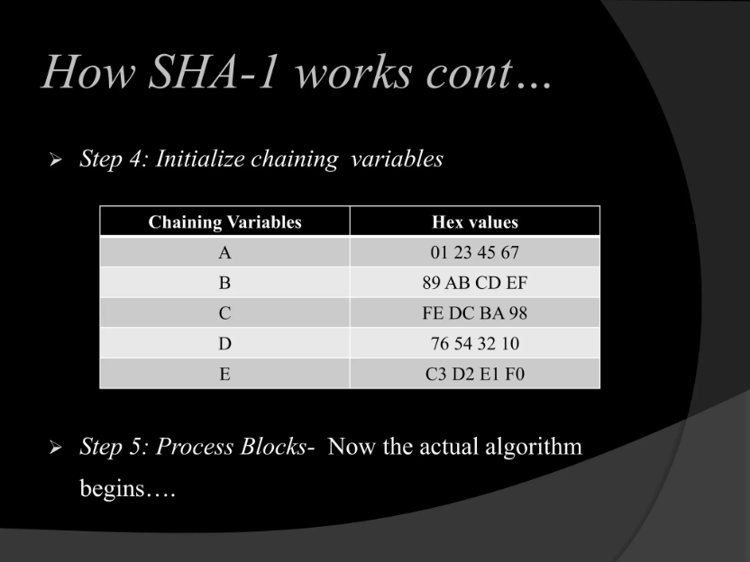

Slide 24
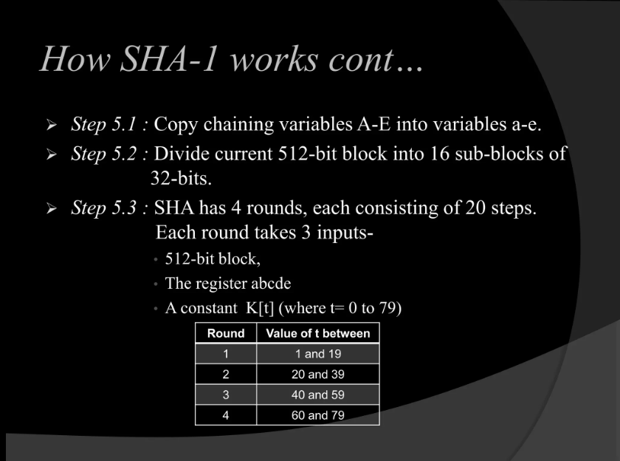

Slide 25
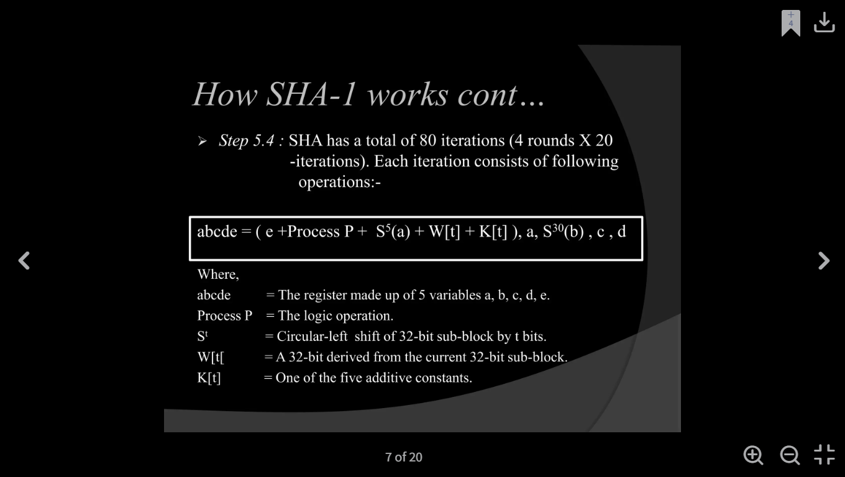

Slide 26
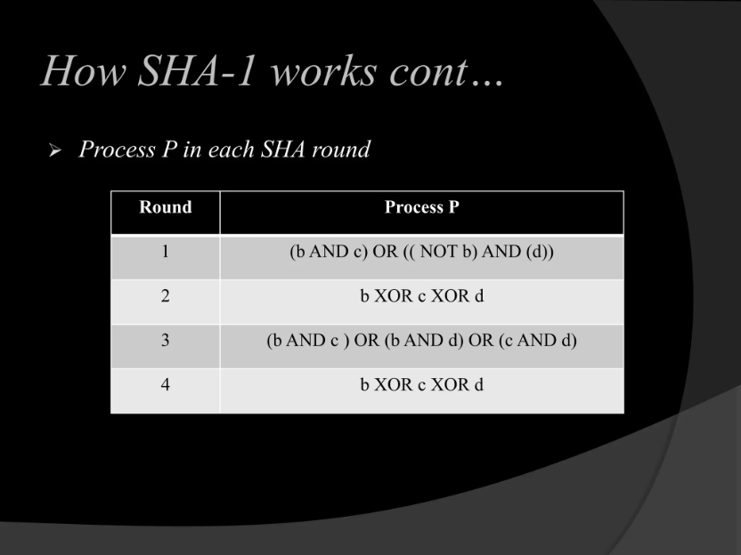

Slide 27
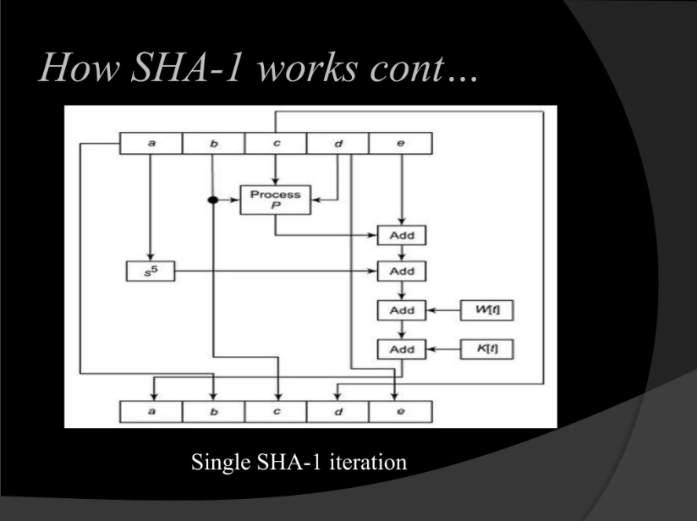

Slide 28
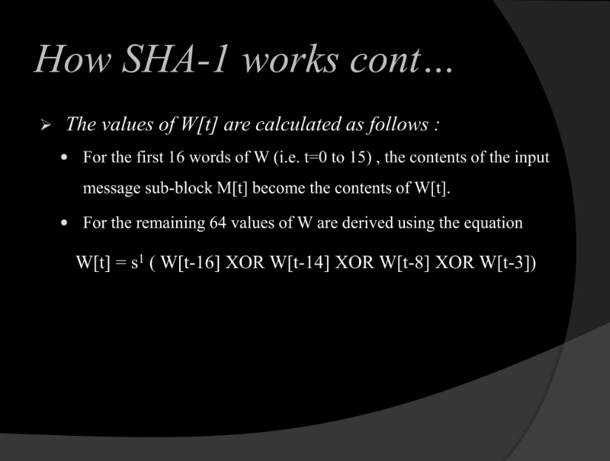

Slide 29
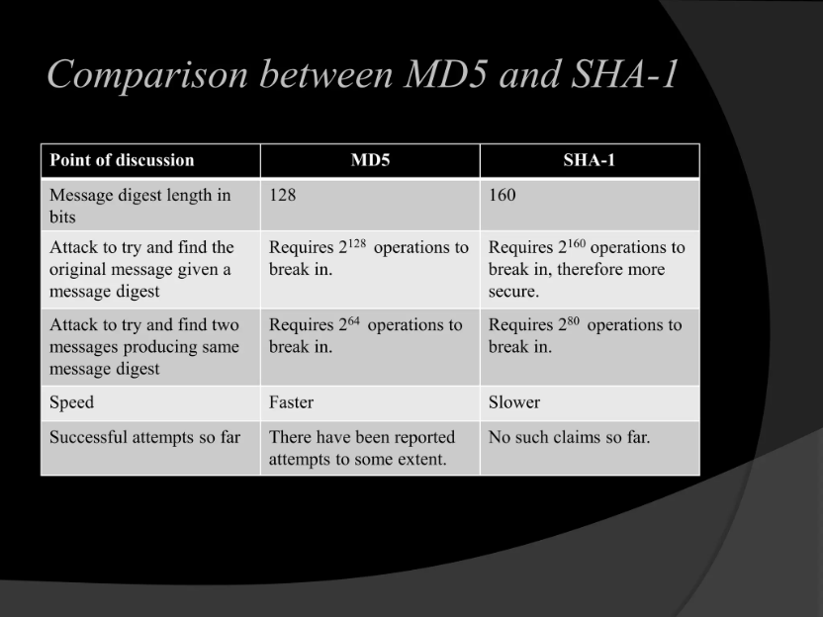

Slide 30
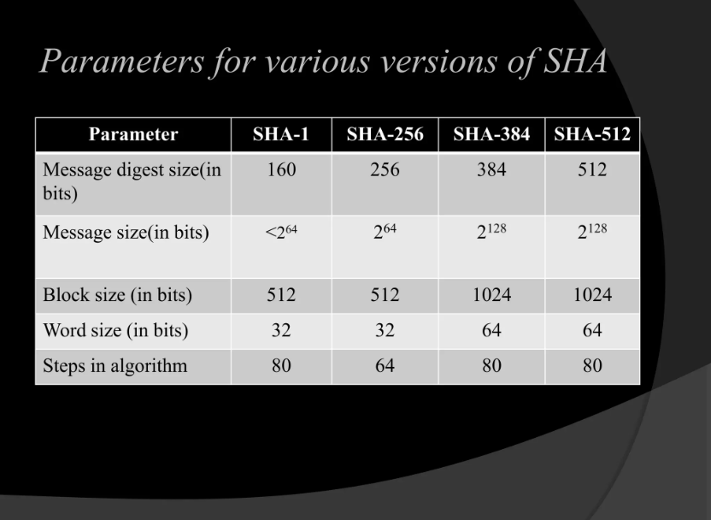

Slide 31
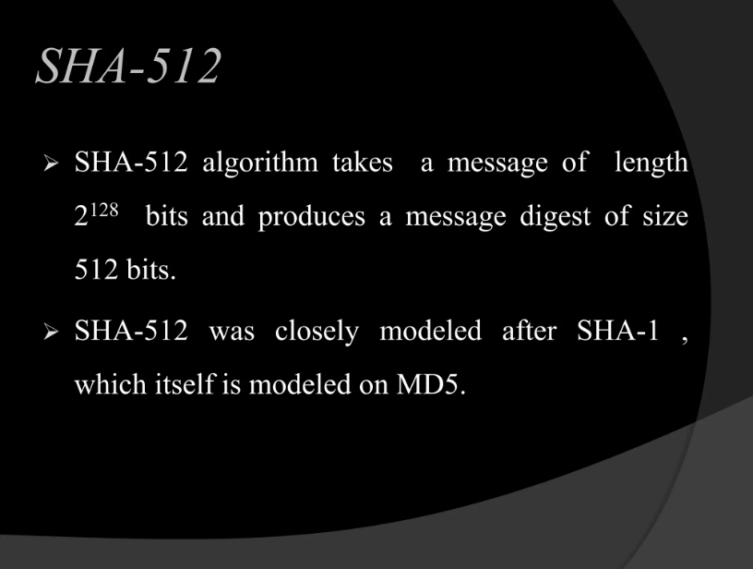

Slide 32
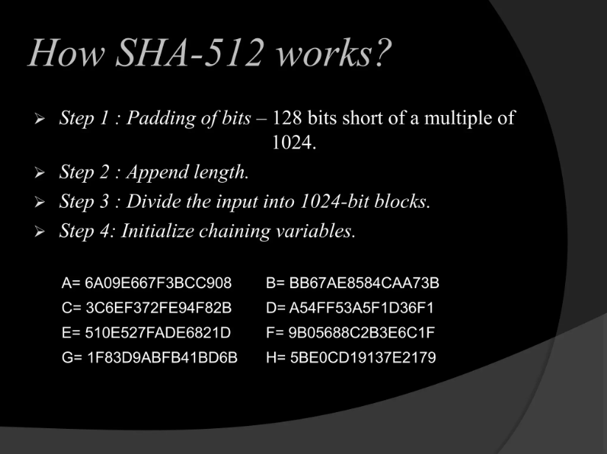

Slide 33
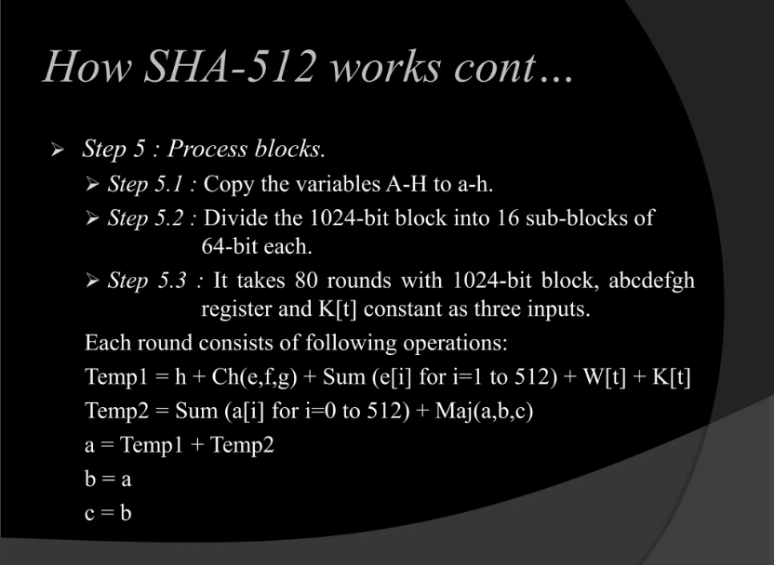

Slide 34
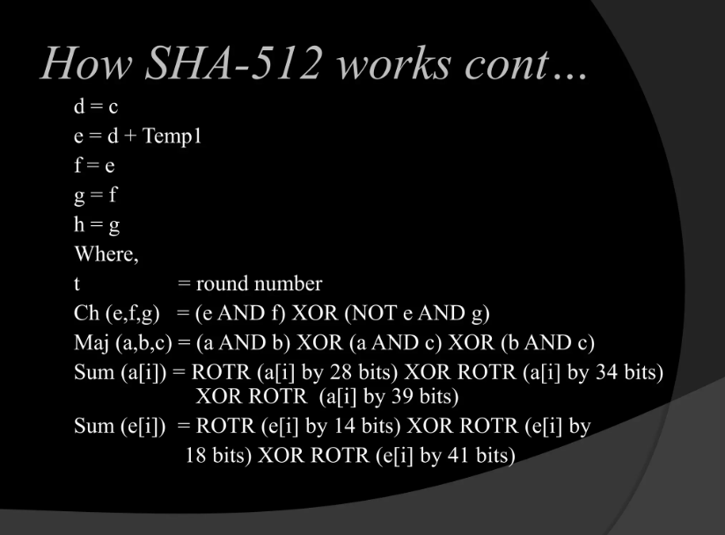

Slide 35
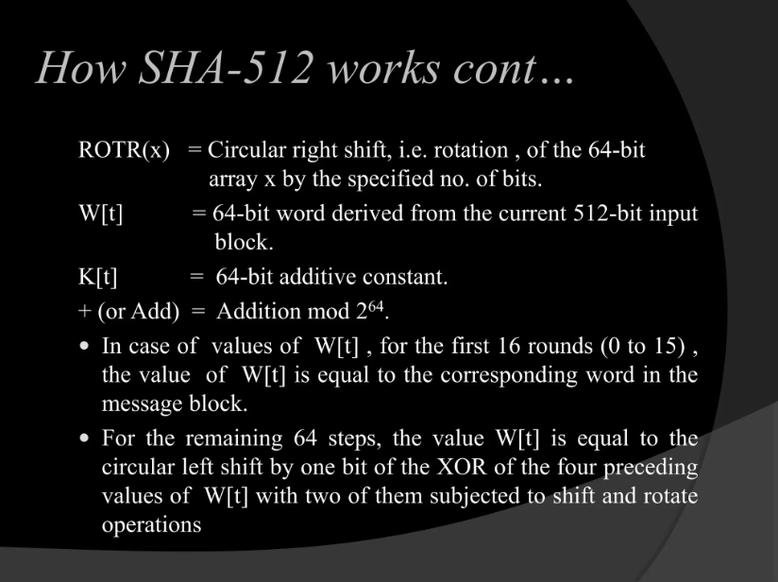

Slide 36
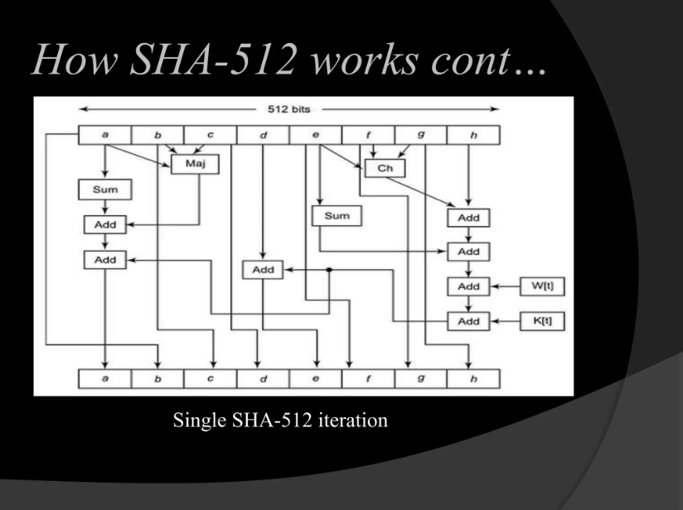

Slide 37
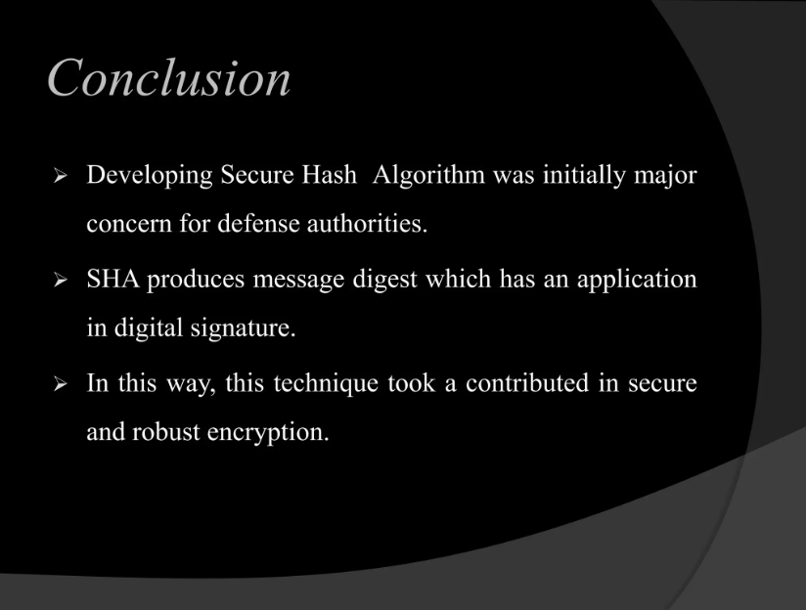

Slide 38
Steganography
Steganography is a method of hiding secret data, by embedding it into an audio, video, image, or text file. It is one of the methods working to protect secret or sensitive data from malicious attacks.
Cryptography and steganography are both methods used to hide or protect secret data. However, they differ in the respect that cryptography makes the data unreadable, or hides the meaning of the data, while steganography hides the existence of the data.
Image Steganography –
Image Steganography refers to the process of hiding data within an image file. The image selected for this purpose is called the cover image and the image obtained after steganography is called the stego image.

Slide 39
How is it done?
An image is represented as an N*M (in case of grayscale images) or N*M*3 (in case of color images) matrix in memory, with each entry representing the intensity value of a pixel.
In image steganography, a message is embedded into an image by altering the values of some pixels, which are chosen by an encryption algorithm.
The recipient of the image must be aware of the same algorithm in order to know which pixels he or she must select to extract the message

Slide 40
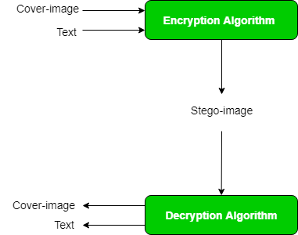

Slide 41
steganography approach involves cover a huge amount of data (picture, audio, and text) within a colour bitmap (bmp) image.
The image will be filtered and segmented with bits replacement applied to the appropriate pixels. These pixels are chosen at random rather than in order.
Detection of the message within the cover image is done by the process of steganalysis.
This can be done through comparison with the cover image, histogram plotting, or noise detection.
Efforts are being invested in developing new algorithms with a greater degree of immunity against such attacks,
Efforts are also being dedicated towards improving existing algorithms for steganalysis, to detect the exchange of secret information between terrorists or criminal

